Slide 1
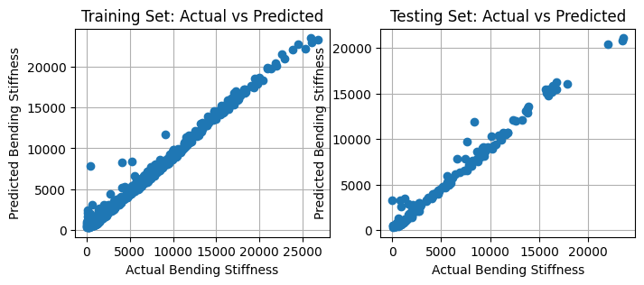
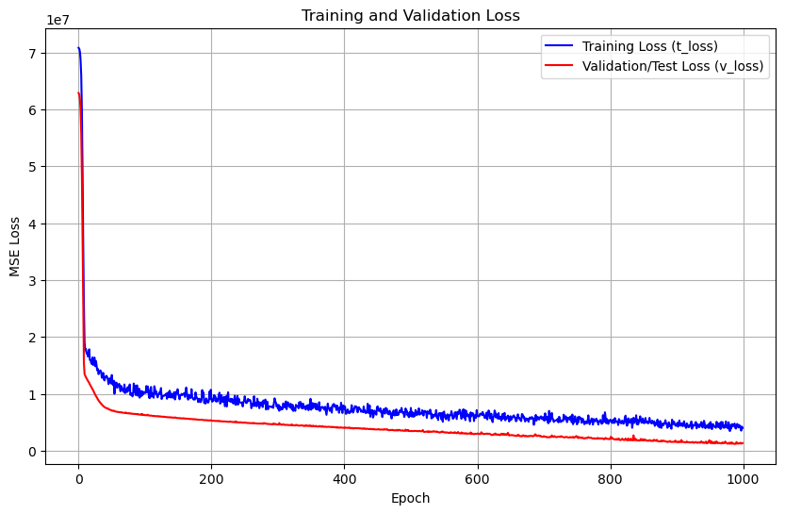
Parameters -> Bending Stiffness
Test Set Metrics:
MSE: 1051895.13
RMSE: 1025.61
MAE: 692.25
R²: 0.9633

Slide 2
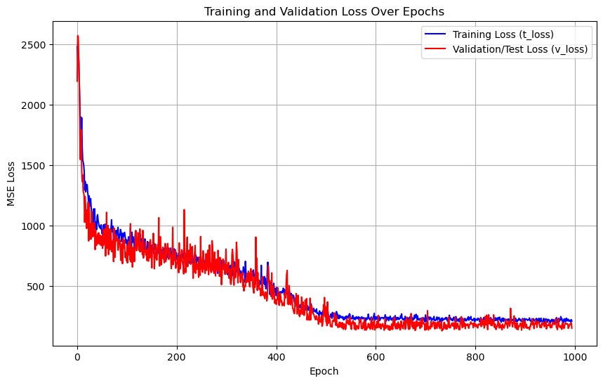
Bending Stiffness -> Parameters
Stats measuring performance over the whole vector [thickness, height, angle]
Might be more revealing using per-dimension stats
How is model doing at predicting individual parameters?
MSE: 151.524666
RMSE: 12.309536
MAE: 8.256471
R²: 0.8704

